Slide 1


Replacement Models and
Maintenance Analysis
https://msmemon.wordpress.com/scmlab/

Slide 2
INTRODUCTION
Organizations providing goods/services use several facilities like equipment and machinery which are directly required in their operations.
In addition to these facilities, there are several other items which are necessary to facilitate the functioning of organizations.
All such facilities should be continuously monitored for their efficient functioning; otherwise, the quality of service will be poor. Besides the quality of service of the facilities, the cost of their operation and maintenance would increase with the passage of time.
Hence, it is an absolute necessity to maintain the equipment in good operating conditions with economical cost.
Thus, we need an integrated approach to minimize the cost of maintenance. In certain cases, the equipment will be obsolete over a period of time.

Slide 3
INTRODUCTION
If a firm wants to be in the same business competitively, it has to take decision on whether to replace the old equipment or to retain it by taking the cost of maintenance and operation into account.
There are two basic reasons for considering the replacement of an equipment—physical impairment of the various parts or obsolescence of the equipment.

Slide 4
INTRODUCTION
Sometimes, the capacity of existing facilities may be inadequate to meet the current demand. Under such situation, the following alternatives will be considered.
  Replacement of the existing equipment with a new one.
  Augmenting the existing one with an additional equipment.

Slide 5
TYPES OF MAINTENANCE
Maintenance activity can be classified into two types: preventive maintenance and breakdown maintenance.
  Preventive maintenance (PM) is the periodical inspection and service activities which are aimed to detect potential failures and perform minor adjustments or repairs which will prevent major operating problems in future.
  Breakdown maintenance is the repair which is generally done after the equipment has attained down state. It is often of an emergency nature which will have associated penalty in terms of expediting cost of maintenance and down time cost of equipment.

Slide 6
TYPES OF REPLACEMENT PROBLEM
Replacement study can be classified as:
  Replacement of assets that deteriorate with time (Replacement due to gradual failure, or wear and tear of the components of the machines).
    This can be further classified into the following types:
      Determination of economic life of an asset.
      Replacement of an existing asset with a new asset.

Slide 7
DETERMINATION OF ECONOMIC LIFE OF AN ASSET
Any asset will have the following cost components:
  Capital recovery cost (average first cost), computed from the first cost (purchase price) of the machine.
  Average operating and maintenance cost (O & M cost)
  Total cost which is the sum of capital recovery cost (average first cost) and average maintenance cost.

Slide 8
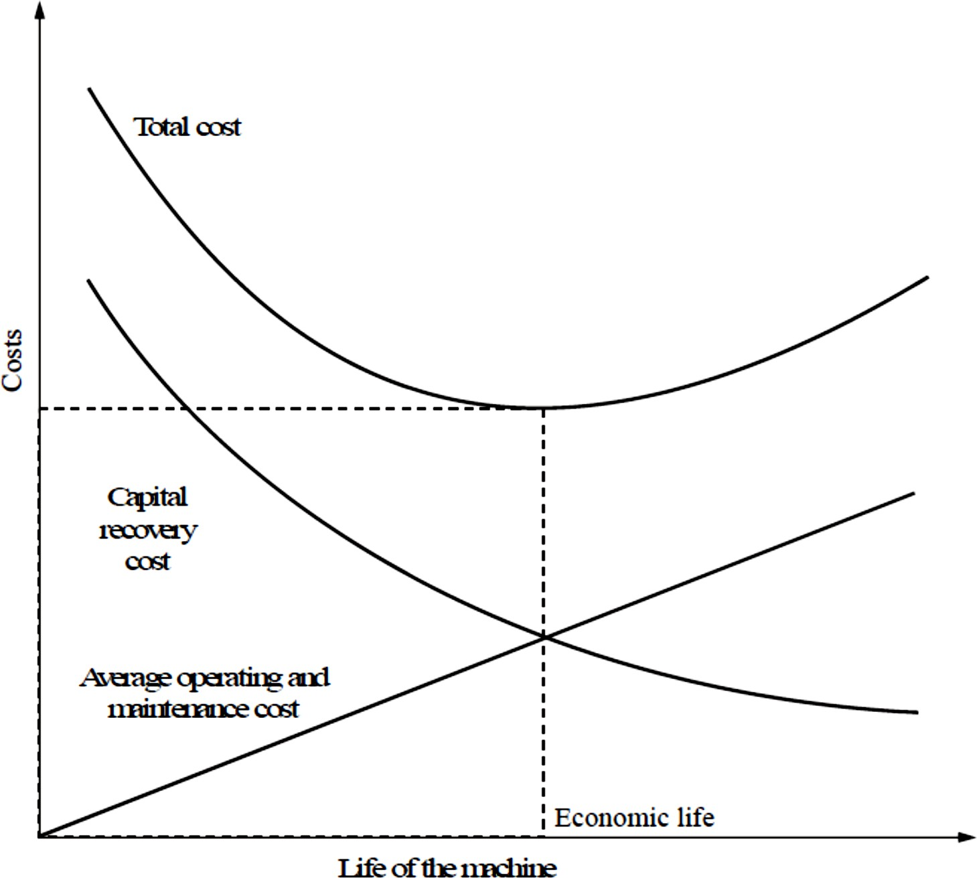
DETERMINATION OF ECONOMIC LIFE OF AN ASSET

Slide 9
DETERMINATION OF ECONOMIC LIFE OF AN ASSET
From Fig. it is clear that the capital recovery cost (average first cost) goes on decreasing with the life of the machine and the average operating and maintenance cost goes on increasing with the life of the machine.
From the beginning, the total cost continues to decrease up to a particular life and then it starts increasing.
The point where the total cost is minimum is called the economic life of the machine.
If the interest rate is more than zero per cent, then we use interest formulas to determine the economic life.

Slide 10
EXAMPLE(3.1)
A firm is considering replacement of an equipment, whose first cost is Rs. 4,000 and the scrap value is negligible at the end of any year.
Based on experience, it was found that the maintenance cost is zero during the first year and it increases by Rs. 200 every year thereafter.
  When should the equipment be replaced if i = 0%.

Slide 11
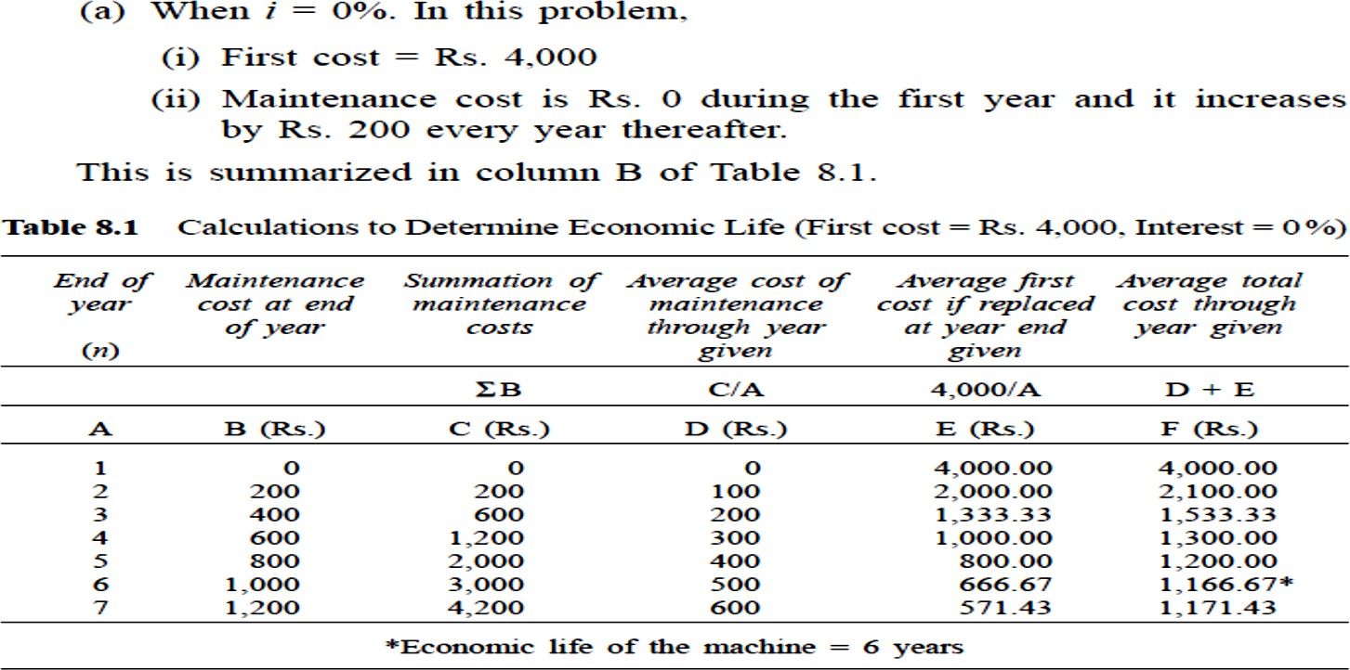
EXAMPLE(3.1)

Slide 12
REPLACEMENT OF EXISTING ASSET WITH A NEW ASSET
In this section, the concept of comparison of replacement of an existing asset with a new asset is presented.
In this analysis, the annual equivalent cost of each alternative should be computed first.
Then the alternative which has the least cost should be selected as the best alternative. Before discussing details, some preliminary concepts which are essential for this type of replacement analysis are presented.

Slide 13
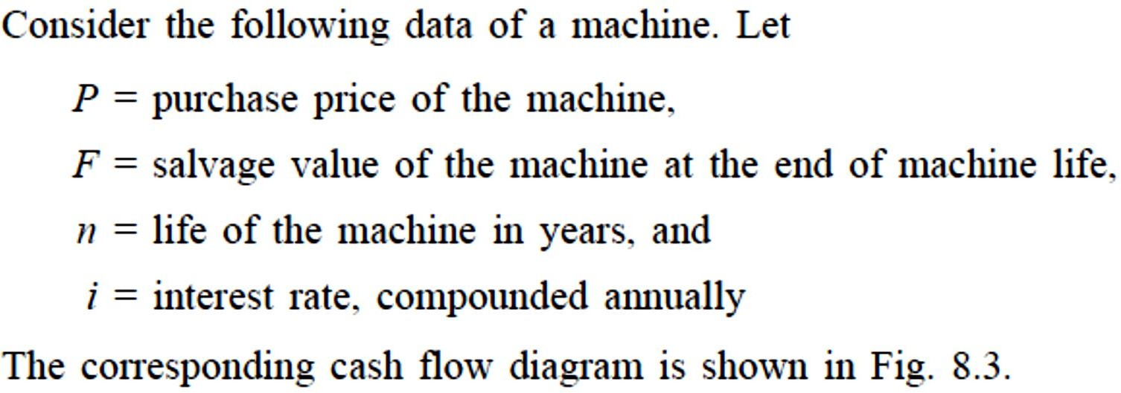
Capital Recovery with Return

Slide 14
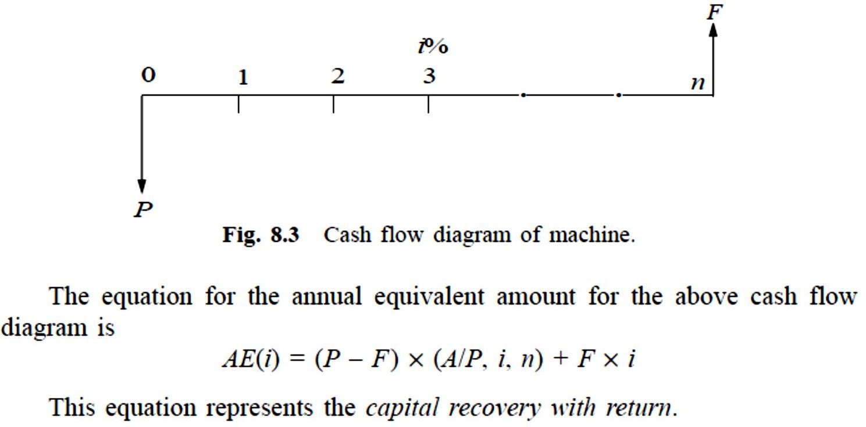
Capital Recovery with Return

Slide 15
Concept of Challenger and Defender
If an existing equipment is considered for replacement with a new equipment, then the existing equipment is known as the defender and the new equipment is known as challenger.
Assume that an equipment has been purchased about three years back for Rs. 5,00,000 and it is considered for replacement with a new equipment. The supplier of the new equipment will take the old one for some money, say, Rs. 3,00,000.
This should be treated as the present value of the existing Equipment and it should be considered for all further economic analysis. The purchase value of the existing equipment before three years is now known as sunk cost, and it should not be considered for further analysis.

Slide 16
EXAMPLE(8.2)
Two years ago, a machine was purchased at a cost of Rs. 2,00,000 to be useful for eight years. Its salvage value at the end of its life is Rs. 25,000. The annual maintenance cost is Rs. 25,000. The market value of the present machine is Rs. 1,20,000. Now, a new machine to cater to the need of the present machine is available at Rs. 1,50,000 to be useful for six years. Its annual maintenance cost is Rs. 14,000. The salvage value of the new machine is Rs. 20,000. Using an interest rate of 12%, find whether it is worth replacing the present machine with the new machine.

Slide 17
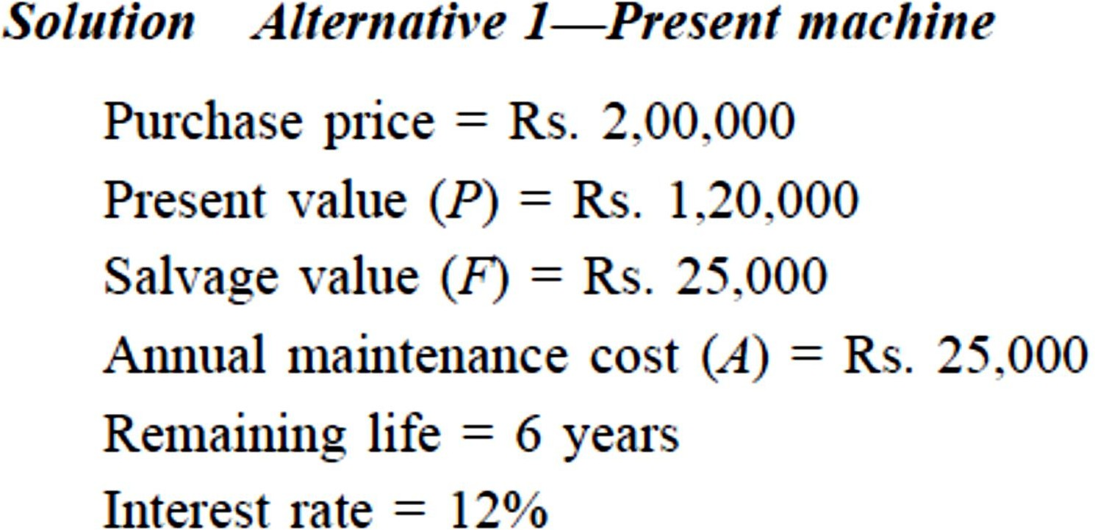
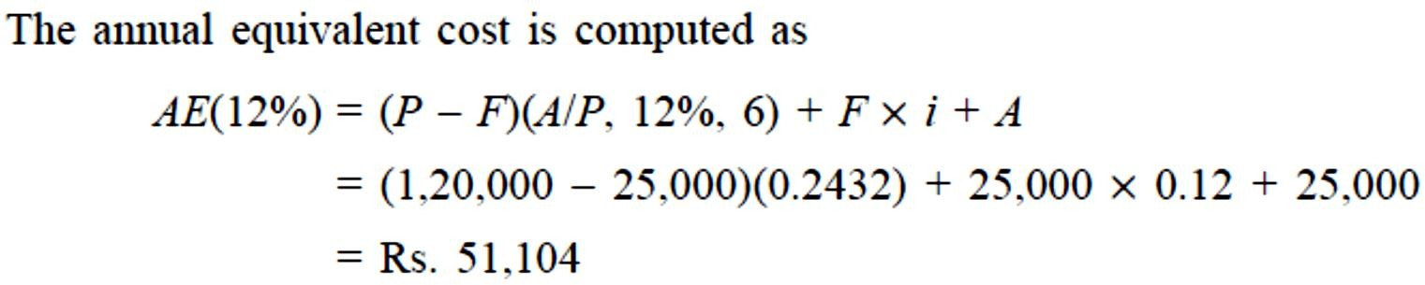
EXAMPLE(8.2)

Slide 18
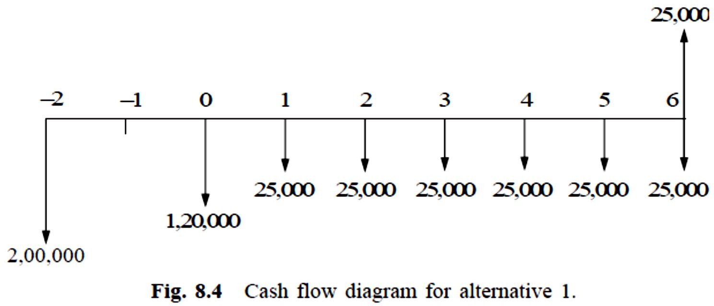
EXAMPLE(8.2)
The cash flow diagram of the present machine is illustrated in Fig. 8.4. The annual maintenance cost for the preceding periods are not shown in this figure.

Slide 19
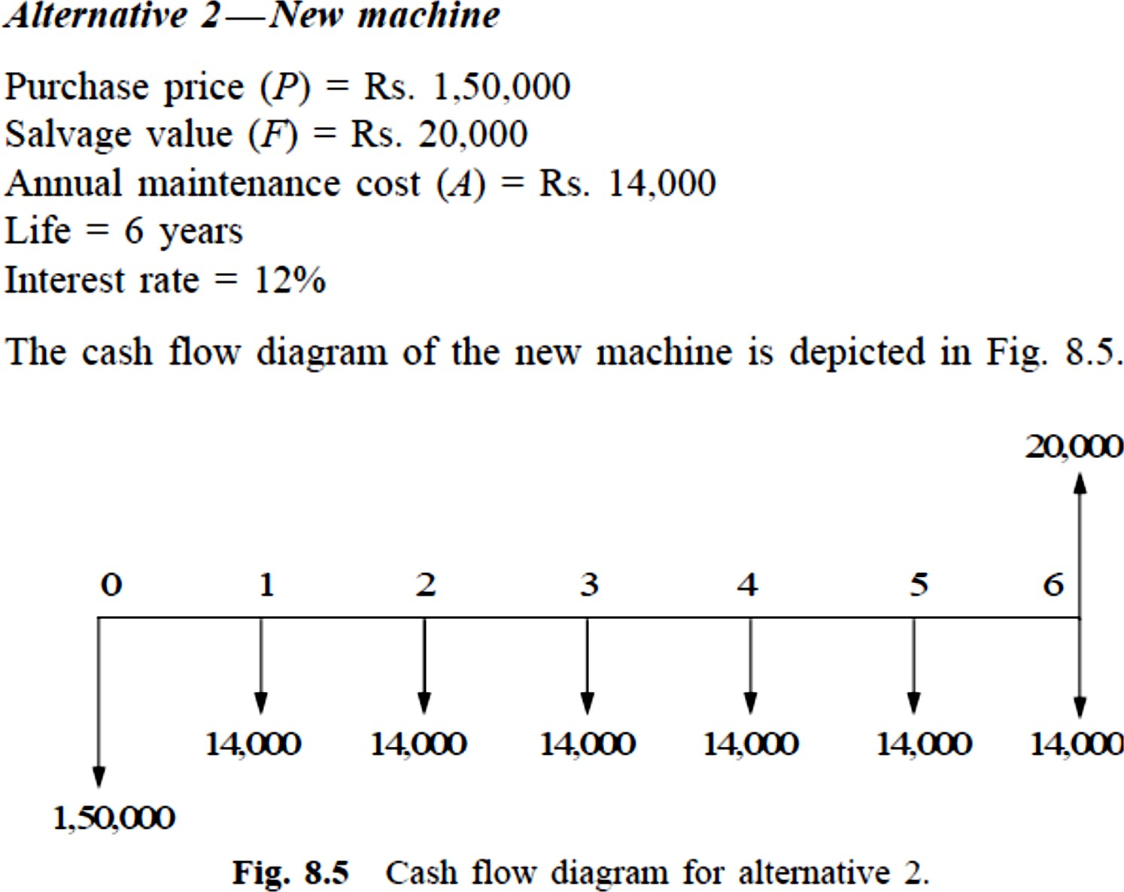
EXAMPLE(8.2)

Slide 20
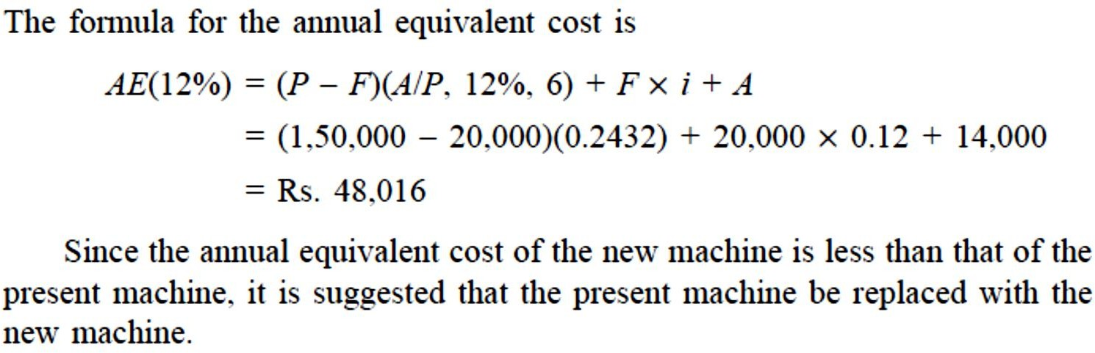
EXAMPLE(8.3)

Slide 21

EXAMPLE(8.3)
A diesel engine was installed 10 years ago at a cost of Rs.R+50,000. It has a present realizable market value of Rs. 15,000+R.
If kept, it can be expected to last five years more, with operating and maintenance cost of Rs. 14,000 per year and to have a salvage value of Rs. 8,000 at the end of the fifth year. This engine can be replaced with an improved version costing Rs.R+65,000 which has an expected life of 20 years.
This improved version will have an estimated annual operating and maintenance cost of Rs. 9,000 and ultimate salvage value of Rs. 13,000.
Using an interest rate of 15%, make an annual equivalent cost analysis to determine whether to keep or replace the old engine.

